Slide 1
IFET COLLEGE OF ENGINEERING
(AN AUTONOMOUS INSTITUTION)
DEPARTMENT OF ELECTRONICS AND COMMUNICATION
MINI PROJECT PRESENTATION 2020-2021
WIRESHARK PACKET SNIFFING

Slide 2
PRESENTED BY
UNDER THE GUIDANCE OF
K.GAYATHRI (421118106017)
THIRD YEAR –ECE (A)
K.KAVIPRIYA (421118106028)
THIRD YEAR –ECE (A)
Mr.B.VINOTHKUMAR SAP/ECE
IFET COLLEGE OF ENGINEERING

Slide 3
Outline
Objective
Introduction to packet sniffing
Types of packet sniffing
Protocols vulnerable to sniffing
Internet
Packet snifffers
Wireshark software
How to detect sniffing?
Countermeasures
references

Slide 4
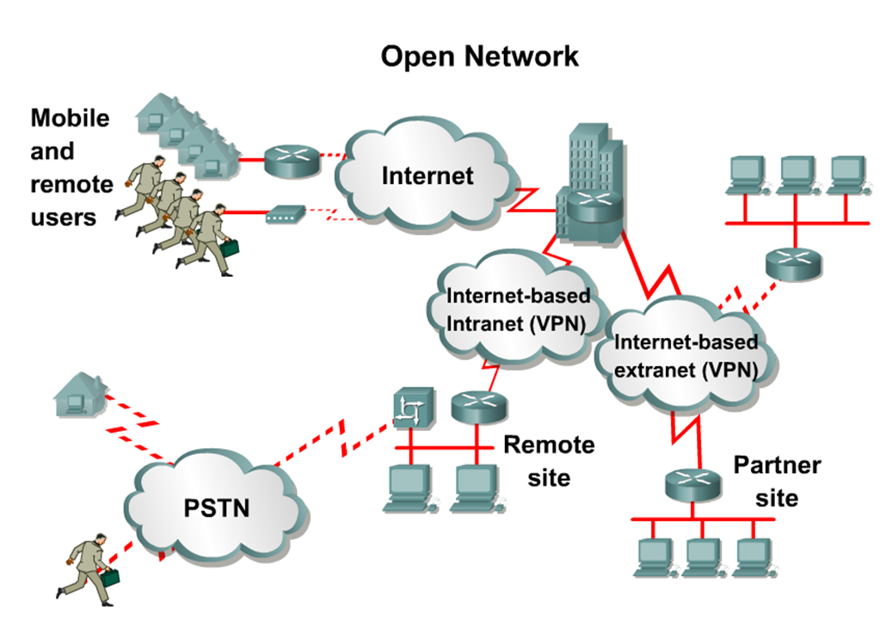
The Network Today:

Slide 5
OBJECTIVE
To analayse the performance of username and password using wireshark packet sniffing method.this method used to get the results of the study is the packet sniffing method researchers can filter data packets from the http protocol application.

Slide 6
INTRODUCTION TO PACKET SNIFFING
Sniffing is a data interception technology.The term sniffing commonly is used to describe protocol analysis, the process of viewing and analyzing the contents of packets on a network.
Tools used for this purpose are properly called protocol analyzers, but the term sniffer also is widely used for such tools.
Protocol analyzers or sniffers are network troubleshooting tools that provide a detailed view of network traffic.
Captures all network traffic.

Slide 7
TYPES OF SNIFFING
Passive sniffing
Passive sniffing means sniffing through a hub
It is difficult to detect
An attacker simply connects to the hub
Active sniffing
Active sniffing means sniffing through a switch
It is easy to detect
Attacker tries to poison the switch by sending bogus MAC
address.

Slide 8
PROTOCOLS VULNERABLE TO SNIFFING
Protocols that are suspectible to sniffers include-
Telnet :Keystrokes including usernames and passwords.
HTTP:Data sent in the clear text.
SMTP:Password and data sent in the clear text.
POP: Password and data sent in the clear text.
FTP: Password and data sent in the clear text.
IMAP
VoIP
SNMP etc.

Slide 9
INTERNET
Internet is based on TCP/IP architecture. The model defines four (or five) layers.
Physical Layer
Data Link Layer: Ethernet. 802.11(2)
Network Layer: IPv4 (IPv6)(3)
Transport Layer: TCP, UDP(4)
Application Layer: SMTP, HTTP, FTP(5)

Slide 10
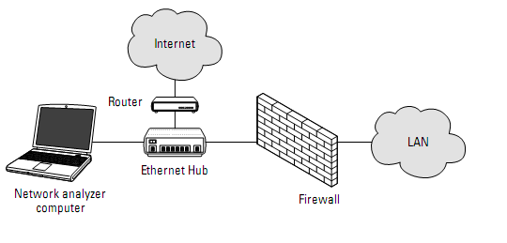
PACKET SNIFFERS
A "Packet Sniffer" is a utility that sniffs without modifying the network's packets in any way.
By comparison,a firewall sees all of a computer’s packet traffic as well.
Packet sniffers merely detect ,display and log this traffic

Slide 11
SOME POPOLAR PACKET SNIFFERS
Linux/Unix-based sniffers use libpcap, which must be installed prior to installing any sniffer.
tcpdump, a command-line based packet sniffer.
tcpshow (tcpdump-based analysis).
Wireshark (Packet sniffer GUI) [Formerly Ethereal]
ngreg — network grep (Command line tool to apply regular expressions to tcpdump output).
Dsniff-is a password sniffer handles FTP,Telnet,SMTP,HTTP,POP etc.

Slide 12
CONTINUATION…..
Windows-based sniffers use WinPcap, which must be installed prior to installing any sniffer.
1.Wireshark(Packet sniffer GUI) [Formerly Ethereal]
2.Capsa Network Analyzer (Packet Sniffer) from Colasoft
3.Cain & Abel from Oxid.it
4. WinDump, a DOS command-line packet sniffer
5.CommViewer

Slide 13
WIRESHARK
Wireshark (formerly Ethereal) is a UNIX- and Windows-based open source network monitoring tool.
Stable release is 1.2.4.Wireshark is a software that "understands" the structure of different networking protocols. Thus, it is able to display the encapsulation and the fields along with their meanings of different packets specified by different networking protocols.
Wireshark uses pcap to capture packets, so it can only capture the packets on the networks supported by pcap.
Data can be captured "from the wire" from a live network connection or read from a file that

Slide 14
CONTINUATION…
records the already-captured packets.
Live data can be read from a number of types of network, including Ethernet, IEEE 802.11, PPP, and loopback.
Captured network data can be browsed via a GUI, or via the terminal (command line) version of the utility, tshark.
Decodes over 750 protocols .
Compatible with many other sniffers .

Slide 15
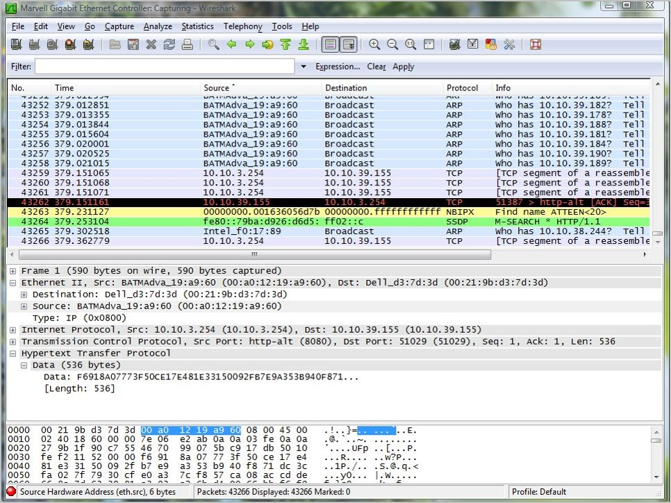
MENUBAR
DISPLAY FILTER SPECIFICATION
Listing of All the Packets
Details of Selected Packet
Header
Packet Content in Hex
& ASCII Code

Slide 16
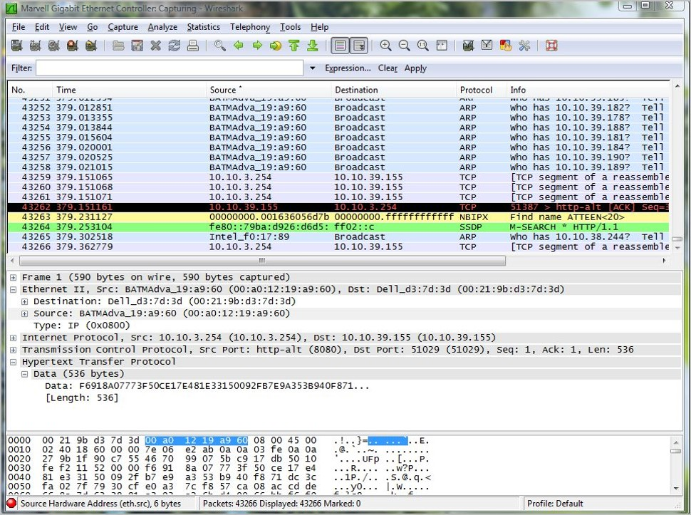
Selected TCP Packet
#43262
DETAILS OF SELECTED DATA

Slide 17
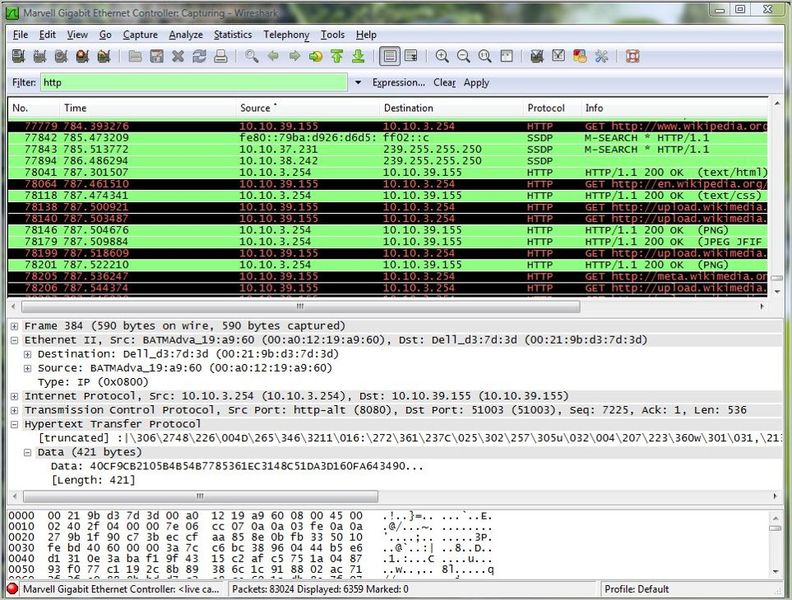
Filtering HTTP Packets Only

Slide 18
HOW TO DETECT SNIFFING?
Check whether the MAC address of some machine(such as a Router) has changed.
Network-based sniffer detection has been hypothesized for a long time. One of the first proof of concepts, Anti-Sniff, was created by L0pht.
Run network tools like HP OpenView or IBM Tivoli to monitor network for strange packets.

Slide 19
COUNTERMEASURES
Host A
Host B
Router A
Router B
The following techniques and tools can be used to mitigate sniffers: Authentication—Using strong authentication, such as one-time passwords, is a first option for defense against packet sniffers.
Switched infrastructure—Migrating to Switched Network Topologies . Shared Ethernet is extremely vulnerable to sniffing.
Antisniffer tools—Use these tools to employ software and hardware designed to detect the use of sniffers on a network.
Cryptography—The best way to defeat sniffing is to encrypt network traffic using Internet Protocol Security (IPSec) or some other mechanism. This won’t stop attackers from sniffing your network, but it will make it harder for them to gain anything useful from their efforts.

Slide 20
REFERENCE
http://en.wikipedia.org
http://www.cet.nau.edu/~mc8/Socket/Tutorials/section1.html
http://www.tcpdump.org/pcap.htm
http://mixter.void.ru/rawip.html
http://www.coders.eu.org/manualy/win/wskfaq/examples/rawping.html
http://www.wireshark.org
http://www.oxid.it

Slide 21
!!!THANK YOU!!!

